Slide 1

GrowEasy
Empowering E-Commerce with AI-Driven Insights
A Scalable, Real-Time Analytics Platform for Shopify Stores.
Predict your next 30 days of sales — in just 30 seconds.
🧠 "Predict. Optimize. Grow."
-Presented by MANAS GANTAIT

Slide 2
Introduction: Why GrowEasy?
Solving Real Pain Points in E-Commerce Analytics.
Narrative Flow:
“E-commerce is booming like never before. In 2024 alone, global online sales hit $5.7 trillion, and Shopify powers over 4 million stores globally.But behind this growth is a hidden challenge — data chaos. Store owners are overwhelmed trying to make sense of complex spreadsheets, multiple tools, and scattered insights.”
Problem Context:
Data overload: Shopify owners deal with product sales, inventory, marketing, and customer data — often with no easy way to interpret trends.
Manual work: Most small businesses still manually export CSVs, analyze in Excel, and guess future demand.
Lack of real-time visibility: Decisions are made based on outdated or incomplete data, leading to poor forecasting and missed opportunities.
GrowEasy’s Purpose:
“GrowEasy empowers Shopify sellers — especially small and medium businesses — with the same level of intelligence that large enterprises use:
✅ Real-time analytics✅ Demand forecasting✅ Automated dashboards✅ AI-powered insights
All without needing to hire a data scientist.”

Slide 3
The Problem: Lost in Data Overload
Manual Analytics
Inaccurate Forecasts
Lost Revenue
E-commerce owners spend countless hours manually extracting and analyzing data, diverting focus from core business activities.
Traditional forecasting methods often lead to overstocking or stockouts, causing lost sales and wasted resources.
Without precise insights, businesses miss opportunities to optimize pricing, marketing, and inventory, directly impacting profitability.
⚠️ Inventory Blind Spots
📉 Missed Market Trends
Small businesses often lack tools to track real-time inventory trends, leading to understocking or overselling. This affects customer trust and leads to poor reviews or cancelled orders.
Without data-driven insights, store owners miss emerging customer preferences or seasonal shifts. This limits their ability to adapt quickly and stay competitive in a fast-paced e-commerce environment.
Imagine a scenario where a popular product suddenly goes out of stock due to an unforeseen surge in demand. That's revenue walking out the door.

Slide 4
Platform Compatibility – Where GrowEasy Works?
Shopify
Fully supported integration
Real-time inventory sync via Webhooks & REST Admin API
WooCommerce
Fetches product, inventory & order data for prediction
Ideal for small to mid-sized WordPress retailers
BigCommerce
⚙️ Integration-ready via BigCommerce API
Supports forecasting + automated inventory strategies
Magento (Adobe Commerce)
Uses ML for bulk demand forecasting
Best suited for high-volume enterprise retailers

Slide 5
The GrowEasy Solution: AI-Driven Automation for Enterprise Retailers
The Challenge
Stockouts or overstocking
Manual, time-consuming analytics
Delayed inventory & pricing updates
How GrowEasy Helps
Auto Data Sync
Real-time Shopify integration via Webhooks/API
Live Event Processing
Serverless AWS (Lambda, DynamoDB) for instant insights
AI Forecasting (SageMaker)
Accurate demand predictions with LSTM models
Smart Dashboards
Real-time KPIs, alerts, and product performance views
Best For
Enterprise Shopify, BigCommerce, or Magento storesManaging 1000+ products with fast-moving inventory

Slide 6






Technical Architecture
Here we will use Shopify platform. Our streamlined process ensures rapid data flow from your Shopify store to actionable insights.
Frontend
React, Tailwind CSS, Recharts.
Backend
AWS Lambda, API Gateway, EventBridge, API Gateway (HTTP Entry Point).
ML Layer
SageMaker (LSTM model for demand forecasting).
Storage
DynamoDB, S3 (for raw and processed data)
Security
IAM Roles, environment secrets
Amazon CloudWatch + API Gateway
CloudWatch: Monitors performance, errors, logs
API Gateway: Serves data to React Dashboard frontend

Slide 7










Why AWS? The Power Behind GrowEasy
We built GrowEasy on Amazon Web Services (AWS) to guarantee performance, reliability, and cost-efficiency.
Scalability
Reliability
Cost-Effective
Seamlessly handles growing data volumes and user traffic.DynamoDB handles 100K+ events/day
Ensures continuous service with high uptime and data integrity.
Pay-as-you-go model optimizes operational expenses.
Serverless
Security
AI/ML Ready
Pay-per-use, perfect for startups.No physical server is needed.
IAM-based resource isolation
Native support for SageMaker to deploy forecasting models without heavy DevOps

Slide 8
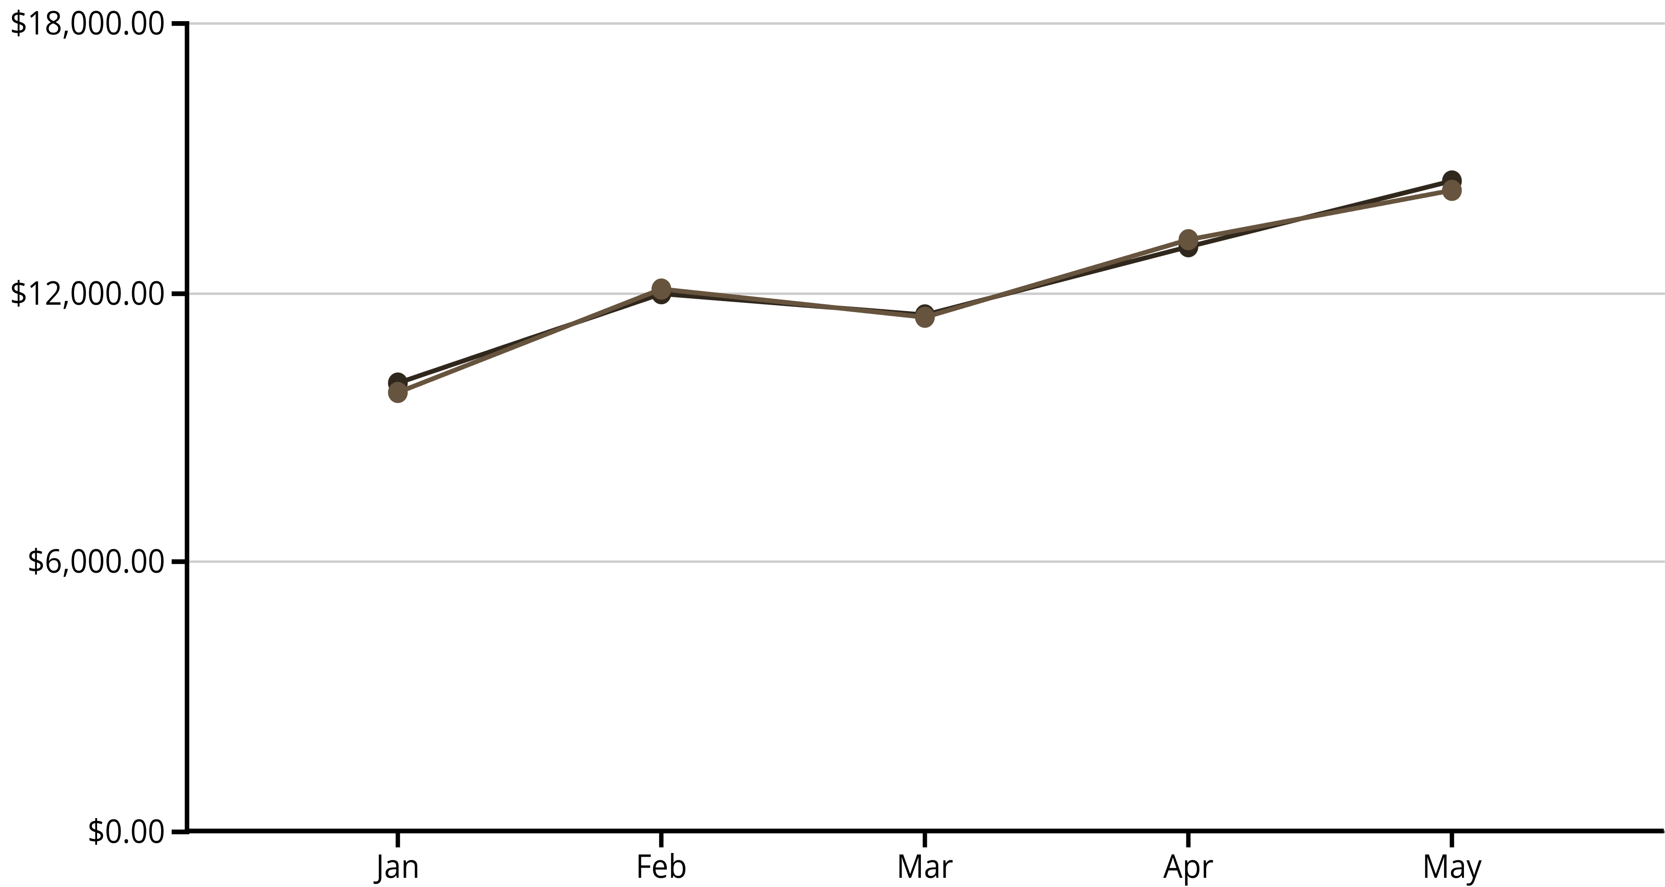
AI-Powered Forecasting: Predict with Confidence
Our proprietary AI models achieve over 95% accuracy in sales predictions, revolutionizing inventory management.
Input: Historical product sales (30–90 days)
Model: SageMaker with time-series forecasting (LSTM/DeepAR)
Output: 7/15/30-day forecasts
Accuracy: 95% on validation datasets
Predicted Sales
Actual Sales

Slide 9
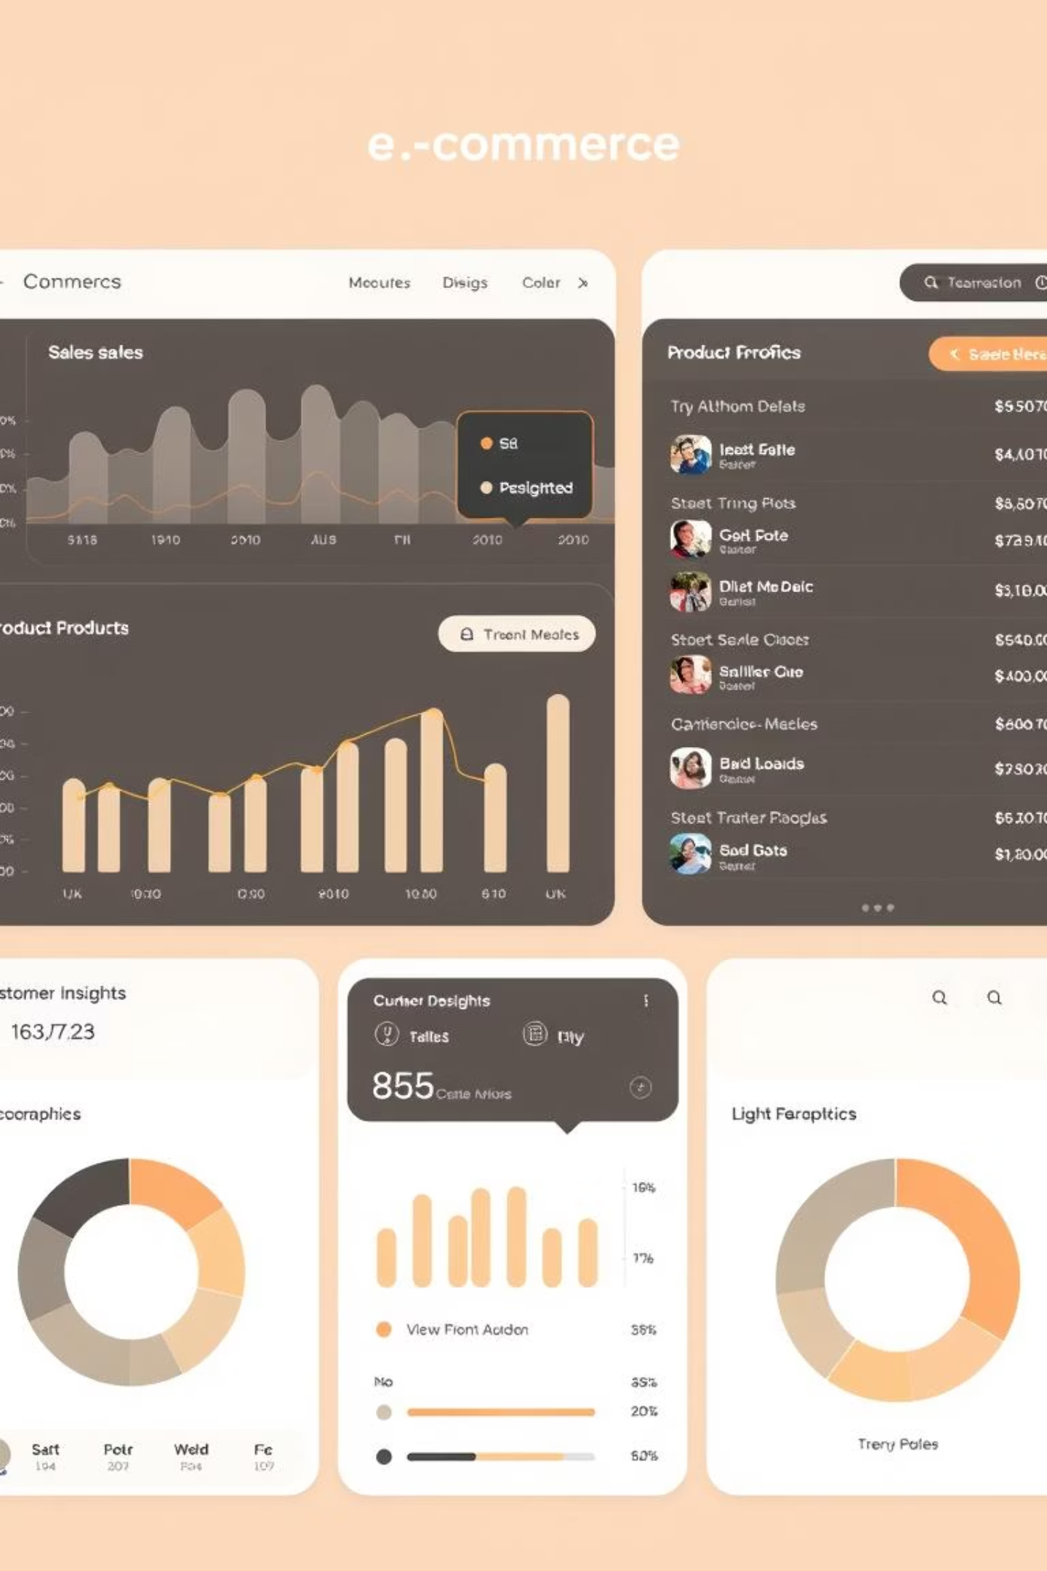
Real-Time Dashboard: Insights at Your Fingertips
Our intuitive dashboard, built with React and Tailwind CSS, provides live metrics and customizable filters for a complete business overview.
Live Sales Data & Trends
Product Performance Analysis
Customer Behavior Insights
Customizable Reports & Alerts
Early testers saved 15+ hours/week on analytics
Reduced deadstock losses by up to ₹1.2 Lakhs
90% of users said it improved business decision-making
Gain instant clarity on your store's performance and easily identify areas for growth.

Slide 10
Vision & Future Roadmap
GrowEasy delivers tangible results that directly impact your bottom line and operational efficiency.
+20%
15+ hrs
80%
Revenue Growth
Time Saved Weekly
Better Decisions
Achieved through optimized inventory and targeted marketing.
Automating analytics frees up valuable time for strategic tasks.
Data-driven insights lead to more effective business strategies.
What’s Next for GrowEasy
🌟 Feature
💡 Description
🧾 Dynamic Pricing Engine
Use real-time demand data + AI to auto-adjust product pricing for maximum profit
🔄 Multi-Store Support
Seamlessly manage inventory & forecasts across multiple Shopify stores
📦 Auto-Restocking
Smart integration with supplier APIs to trigger auto-purchase orders when inventory drops
🛍️ Platform Expansion
Connect with WooCommerce, Amazon Seller Central, and more marketplaces

Slide 11
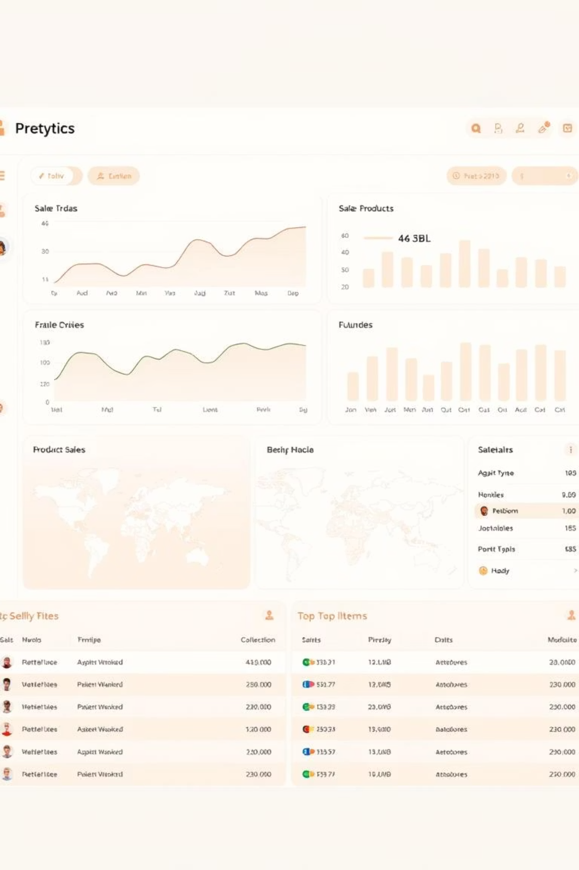
Key Features – GrowEasy at a Glance
Power-Packed Features Designed for Retail Success
Instant Forecasting
95% accurate predictions using AI-powered LSTM time-series models
📊 Live Dashboards
Real-time insights via React, Tailwind CSS, and Recharts
Auto Alerts
Smart notifications for low stock, sales dips, and emerging trends
Plug & Play
1-click Shopify integration — no setup hassle, no manual syncing

Slide 12
Thank You!

